Slide 1
Data analytics Training

Slide 2
Labs

Slide 3
Views
A view is a virtual table that is based on the result of a SELECT statement.
A view does not store data itself, but instead retrieves data from one or more tables in the database when it is accessed.
Security
Simplicity
Consistency

Slide 4
Nested queries
Outer query
Inner query

Slide 5
Flow of execution
from
where
group
having
aggregate
select
order

Slide 6
Example
Products
Prod_ID | ID | Prod_Name | quantity | Amount
M01 | C10 | Desktop | 10 | 200k
M02 | C12 | Mouse | 31 | 50k
M03 | C11 | Software | 10 | 150k
M04 | C13 | Table | 32 | 50k
M05 | C13 | Cabin | 21 | 120k
M06 | C10 | Bulb | 100 | 15k
Employee
ID | Name | Level
C10 | Watson | Level one
C11 | Frank | Level two
C12 | Abhi | Level one
c13 | Adam | Level two
Select ID, Name
From Employee
Where Level= ‘Level two’ And ID in (Select ID from Products
where amount>100k and quantity>20)

Slide 7
Select ID from Products where amount>100k and quantity>20
C13
Select ID, Name
From Employee
Where Level= ‘Level two’ And ID in c13
c13 | Adam

Slide 8
Window function or Analytic function
A window function in SQL is a function that operates on a set of rows defined by the ORDER BY clause in a SELECT statement.

Slide 9
Aggregate function()
Row_number()
Rank()
Dense_rank()
Lead()
Lag()
Cume_dist
Ntile
Nth_value
Percent_rank

Slide 10
Row_number
select e.*,
row_number() over() as rn
from employee e;
select e.*,
row_number() over(partition by dept_name) as rn
from employee e;
select e.*,
row_number() over(partition by dept_name order by id) as rn
from employee e;

Slide 11
Top N (rank)
Select * from (
select e.*,
rank() over(partition by dept_name order by id order by salary desc) as rnk
from employee e) x
Where x.rnk < 4;

Slide 12
Dense_rank
SELECT product_name, sales,
DENSE_RANK() OVER (ORDER BY sales DESC) AS sales_rank
FROM products;
product_name | sales
Product A | 100
Product B | 200
Product C | 200
Product D | 300
product_name | sales | sales_rank
Product D | 300 | 1
Product B | 200 | 2
Product C | 200 | 2
Product A | 100 | 3

Slide 13
Lag and Lead
Fetch a query to display if the marks of an student is higher, lower or equal to the previous employee. (Lag)
Fetch a query to display if the marks of an student is higher, lower or equal to the next employee. (Lead)

Slide 14
Lag
SELECT name, marks,
CASE
WHEN marks > LAG(marks) OVER (ORDER BY name) THEN 'Higher’ WHEN marks < LAG(marks) OVER (ORDER BY name) THEN 'Lower’ ELSE 'Equal’
END AS comparison
FROM students;
name | marks | comparison
John | 80 | Equal
Jane | 90 | Higher
Jim | 70 | Lower
Joan | 80 | Higher

Slide 15
Lead
SELECT name, marks,
CASE
WHEN marks > LEAD(marks) OVER (ORDER BY name) THEN 'Higher’ WHEN marks < LEAD(marks) OVER (ORDER BY name) THEN 'Lower’ ELSE 'Equal’
END AS comparison
FROM students;
name | marks | comparison
John | 80 | Lower
Jane | 90 | Higher
Jim | 70 | Higher
Joan | 80 | Equal

Slide 16
First value and last value
Most expensive product in each category (First_value)
Least expensive product in each category (Last_value)
product_name | category | price
Product B | Category 1 | 150
Product D | Category 2 | 300
product_name | category | price
Product A | Category 1 | 100
Product B | Category 1 | 150
Product C | Category 2 | 200
Product D | Category 2 | 300
product_name | category | price
Product B | Category 1 | 100
Product D | Category 2 | 200

Slide 17
Nth_value
Second most expensive products in each category

Slide 18
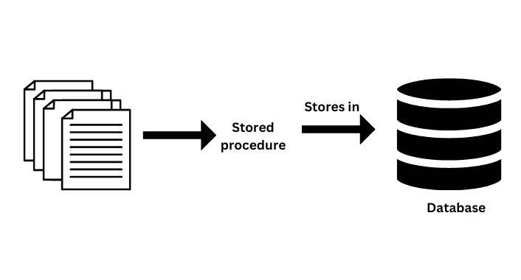
Stored procedure
Stored procedures allow you to group several SQL statements and procedural logic into a single unit that can be called and executed multiple times.

Slide 19
Why it is used
It is mostly used for repetitive tasks such as inserting, updating, or deleting data, generating reports, or performing calculations.
By encapsulating these operations in a stored procedure,
you can improve database performance,
reduce network traffic,
enhance security by controlling access to the database.

Slide 20
Database optimization

